Slide 1
Lecture 5: File System Implementation

Slide 2
The Course Organization (Bottom-up)
Race Conditions, Lock/Semaphore
Concurrency
Thread
Memory Management
HW#4
Virtualization
Process and CPU Scheduling
HW#3
IO Devices and Storage
HW#2
&
Project
Persistence
File System
System Calls (User-level Programming)
HW#1

Slide 3
The Way To Think
There are two different aspects to implement file system
Data structures
What types of on-disk structures are utilized by the file system to organize its data and metadata?
Access methods
How does it map the calls made by a process as open(), read(), write(), etc.
Which structures are read during the execution of a particular system call?

Slide 4
Overall Organization
Let’s develop the overall organization of the file system data structure.
Divide the disk into blocks.
Block size is 4 KB.
The blocks are addressed from 0 to N -1.
0 7
8 15
16 23
24 31
32 39
40 47
48 55
56 63

Slide 5
Data region in file system
Reserve data region to store user data
File system has to track which data block comprise a file, the size of the file, its owner, etc.
Data Region
D | D | D | D | D | D | D | D
D | D | D | D | D | D | D | D
D | D | D | D | D | D | D | D
0 7
8 15
16 23
24 31
Data Region
D | D | D | D | D | D | D | D
D | D | D | D | D | D | D | D
D | D | D | D | D | D | D | D
D | D | D | D | D | D | D | D
32 39
40 47
48 55
56 63
How we store these inodes in file system?

Slide 6
Inode table in file system
Reserve some space for inode table
This holds an array of on-disk inodes.
Ex) inode tables : 3 ~ 7, inode size : 256 bytes
4-KB block can hold 16 inodes.
The filesystem contains 80 inodes. (maximum number of files)
Inodes
Data Region
 | i | d | I | I | I | I | I
D | D | D | D | D | D | D | D
D | D | D | D | D | D | D | D
D | D | D | D | D | D | D | D
0 7
8 15
16 23
24 31
Data Region
D | D | D | D | D | D | D | D
D | D | D | D | D | D | D | D
D | D | D | D | D | D | D | D
D | D | D | D | D | D | D | D
32 39
40 47
48 55
56 63

Slide 7
Allocation structures
This is to track whether inodes or data blocks are free or allocated.
Use bitmap, each bit indicates free(0) or in-use(1)
data bitmap: for data region for data region
inode bitmap: for inode table
Inodes
Data Region
 | i | d | I | I | I | I | I
D | D | D | D | D | D | D | D
D | D | D | D | D | D | D | D
D | D | D | D | D | D | D | D
0 7
8 15
16 23
24 31
Data Region
D | D | D | D | D | D | D | D
D | D | D | D | D | D | D | D
D | D | D | D | D | D | D | D
D | D | D | D | D | D | D | D
32 39
40 47
48 55
56 63

Slide 8
Superblock
Super block contains this information for particular file system
Ex) The number of inodes, begin location of inode table. etc
Thus, when mounting a file system, OS will read the superblock first, to initialize various information.
Inodes
Data Region
S | i | d | I | I | I | I | I
D | D | D | D | D | D | D | D
D | D | D | D | D | D | D | D
D | D | D | D | D | D | D | D
0 7
8 15
16 23
24 31
Data Region
D | D | D | D | D | D | D | D
D | D | D | D | D | D | D | D
D | D | D | D | D | D | D | D
D | D | D | D | D | D | D | D
32 39
40 47
48 55
56 63

Slide 9
File Organization: The inode
Each inode is referred to by inode number.
by inode number, File system calculate where the inode is on the disk.
Ex) inode number: 32
Calculate the offset into the inode region (32 x sizeof(inode) (256 bytes) = 8192
Add start address of the inode table(12 KB) + inode region(8 KB) = 20 KB
The Inode table
iblock 0
iblock 1
iblock 2
iblock 3
iblock 4
Super | i-bmap | d-bmap | 0 | 1 | 2 | 3 | 16 | 17 | 18 | 19 | 32 | 33 | 34 | 35 | 48 | 49 | 50 | 51 | 64 | 65 | 66 | 67
 |  |  | 4 | 5 | 6 | 7 | 20 | 21 | 22 | 23 | 36 | 37 | 38 | 39 | 52 | 53 | 54 | 55 | 68 | 69 | 70 | 71
 |  |  | 8 | 9 | 10 | 11 | 24 | 25 | 26 | 27 | 40 | 41 | 42 | 43 | 56 | 57 | 58 | 59 | 72 | 73 | 74 | 75
 |  |  | 12 | 13 | 14 | 15 | 28 | 29 | 30 | 31 | 44 | 45 | 46 | 47 | 60 | 61 | 62 | 63 | 76 | 77 | 78 | 79
0KB
4KB
8KB
12KB
16KB
20KB
24KB
28KB
32KB

Slide 10
File Organization: The inode (Cont.)
Disks are not byte addressable, but sector addressable.
Disk consist of a large number of addressable sectors, (512 bytes)
Ex) Fetch the block of inode (inode number: 32)
Sector address iaddr of the inode block:
blk : (inumber * sizeof(inode)) / blocksize
sector : ((blk * blocksize) + inodeStartAddr ) /sectorsize
The Inode table
iblock 0
iblock 1
iblock 2
iblock 3
iblock 4
Super | i-bmap | d-bmap | 0 | 1 | 2 | 3 | 16 | 17 | 18 | 19 | 32 | 33 | 34 | 35 | 48 | 49 | 50 | 51 | 64 | 65 | 66 | 67
 |  |  | 4 | 5 | 6 | 7 | 20 | 21 | 22 | 23 | 36 | 37 | 38 | 39 | 52 | 53 | 54 | 55 | 68 | 69 | 70 | 71
 |  |  | 8 | 9 | 10 | 11 | 24 | 25 | 26 | 27 | 40 | 41 | 42 | 43 | 56 | 57 | 58 | 59 | 72 | 73 | 74 | 75
 |  |  | 12 | 13 | 14 | 15 | 28 | 29 | 30 | 31 | 44 | 45 | 46 | 47 | 60 | 61 | 62 | 63 | 76 | 77 | 78 | 79
0KB
4KB
8KB
12KB
16KB
20KB
24KB
28KB
32KB

Slide 11
File Organization: The inode (Cont.)
inode have all of the information about a file
File type (regular file, directory, etc.),
Size, the number of blocks allocated to it.
Protection information(who ones the file, who can access, etc).
Time information.
Etc.

Slide 12
File Organization: The inode (Cont.)
Size Name What is this inode field for?
2 mode can this file be read/written/executed?
2 uid who owns this file?
4 size how many bytes are in this file?
4 time what time was this file last accessed?
4 ctime what time was this file created?
4 mtime what time was this file last modified?
4 dtime what time was this inode deleted?
4 gid which group does this file belong to?
2 links_count how many hard links are there to this file?
2 blocks how many blocks have been allocated to this file?
4 flags how should ext2 use this inode?
4 osd1 an OS-dependent field
60 block a set of disk pointers (15 total)
4 generation file version (used by NFS)
4 file_acl a new permissions model beyond mode bits
4 dir_acl called access control lists
4 faddr an unsupported field
12 i_osd2 another OS-dependent field
The EXT2 Inode

Slide 13
The Multi-Level Index
To support bigger files, we use multi-level index.
Indirect pointer points to a block that contains more pointers.
inode have fixed number of direct pointers (12) and a single indirect pointer.
If a file grows large enough, an indirect block is allocated, inode’s slot for an indirect pointer is set to point to it.
(12 + 1024) x 4 K or 4144 KB

Slide 14
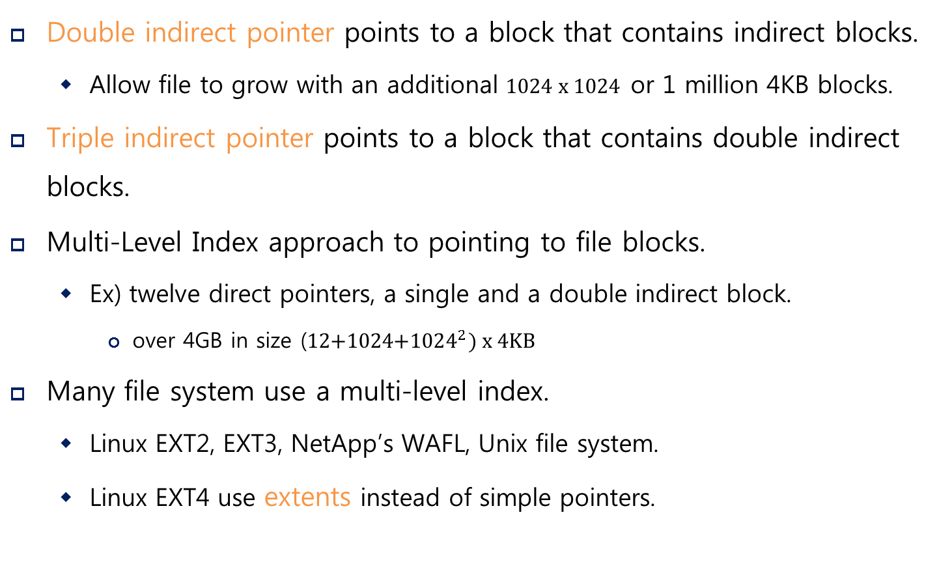
The Multi-Level Index (Cont.)
Double indirect pointer points to a block that contains indirect blocks.
Allow file to grow with an additional 1024 x 1024 or 1 million 4KB blocks.
Triple indirect pointer points to a block that contains double indirect blocks.
Multi-Level Index approach to pointing to file blocks.
Ex) twelve direct pointers, a single and a double indirect block.
over 4GB in size (12+1024+${1024}^{2}) x 4KB$
Many file system use a multi-level index.
Linux EXT2, EXT3, NetApp’s WAFL, Unix file system.
Linux EXT4 use extents instead of simple pointers.

Slide 15
The Multi-Level Index (Cont.)
Most files are small Roughly 2K is the most common size
Average file size is growing Almost 200K is the average
Most bytes are stored in large files A few big files use most of the space
File systems contains lots of files Almost 100K on average
File systems are roughly half full Even as disks grow, file system remain -50% full
Directories are typically small Many have few entries; most have 20 or fewer
File System Measurement Summary

Slide 16
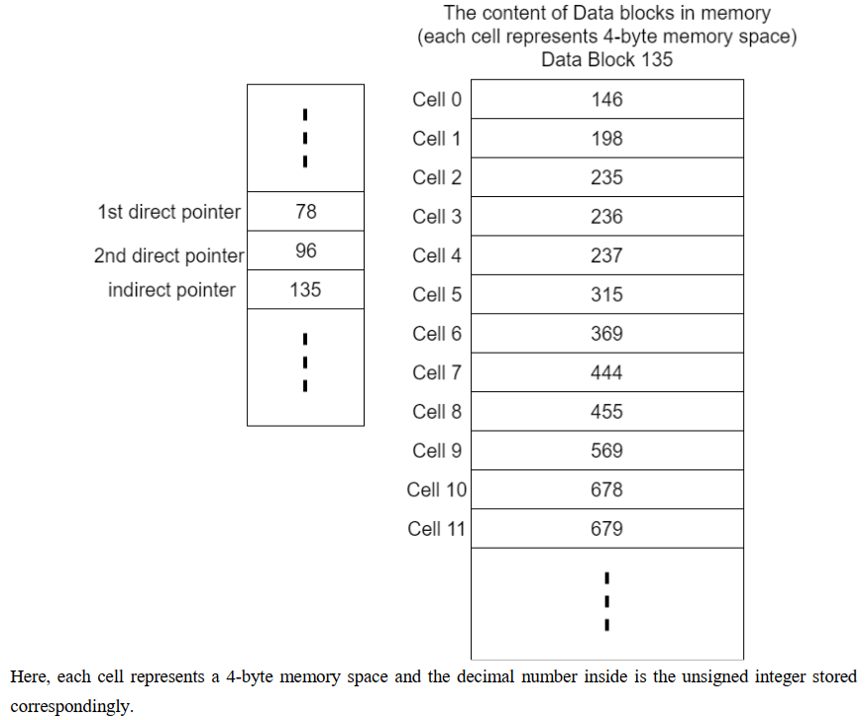
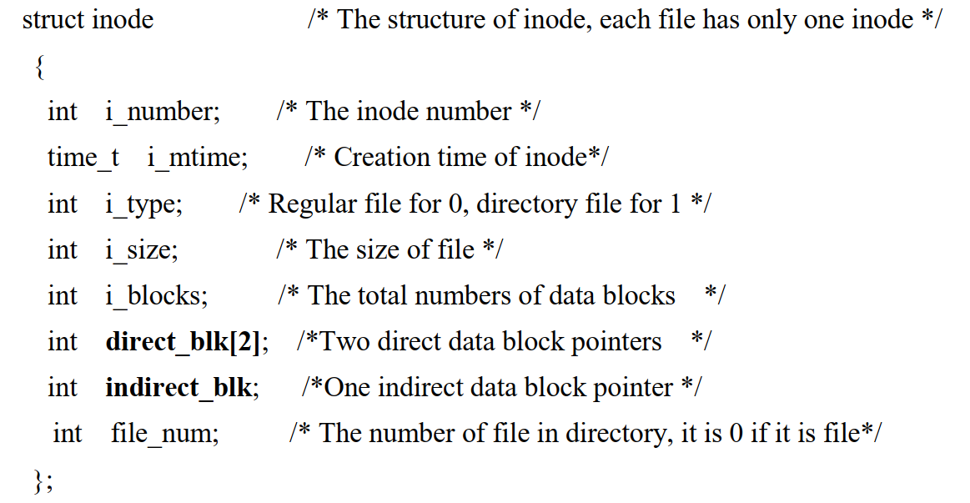
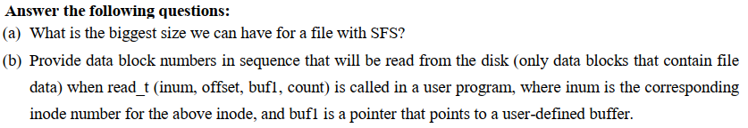
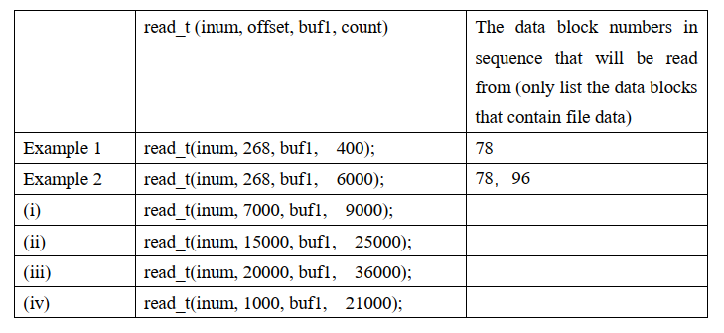
Example

Slide 17
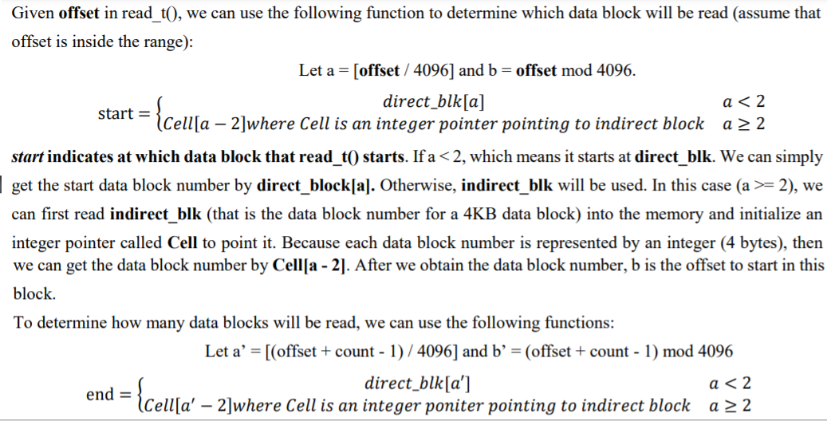
Solution

Slide 18
Directory Organization
Directory contains a list of (entry name, inode number) pairs.
Each directory has two extra files .”dot” for current directory and ..”dot-dot” for parent directory
For example, dir has three files (foo, bar, foobar_is_a_pretty_longname)
inum | reclen | strlen | name
5 12 2 .
2 12 3 ..
12 12 4 foo
13 12 4 bar
24 36 28 foobar_is_a_pretty_longname
on-disk for dir

Slide 19
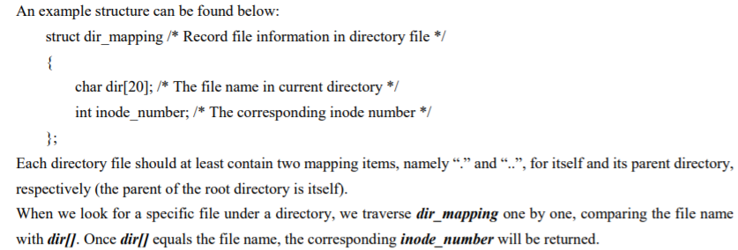
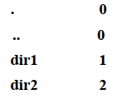
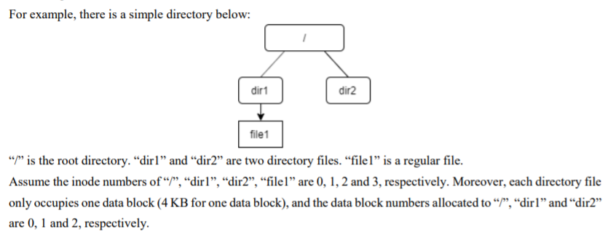

Example
Question: What is the content of Block 0?
Answer:
Question:
Answer:

Slide 20
Free Space Management
File system track which inode and data block are free or not.
In order to manage free space, we have two simple bitmaps.
When file is newly created, it allocated inode by searching the inode bitmap and update on-disk bitmap.
Pre-allocation policy is commonly used for allocate contiguous blocks.

Slide 21
Access Paths: Reading a File From Disk
Issue an open(“/foo/bar”, O_RDONLY),
Traverse the pathname and thus locate the desired indoe.
Begin at the root of the file system (/)
In most Unix file systems, the root inode number is 2
Filesystem reads in the block that contains inode number 2.
Look inside of it to find pointer to data blocks (contents of the root).
By reading in one or more directory data blocks, it will find “foo” directory.
Traverse recursively the path name until the desired inode (“bar”)
Check finale permissions, allocate a file descriptor for this process and returns file descriptor to user.

Slide 22
Access Paths: Reading a File From Disk (Cont.)
Issue read() to read from the file.
Read in the first block of the file, consulting the inode to find the location of such a block.
Update the inode with a new last accessed time.
Update in-memory open file table for file descriptor, the file offset.
When file is closed:
File descriptor should be deallocated, but for now, that is all the file system really needs to do. No disk I/Os take place.

Slide 23
Access Paths: Reading a File From Disk (Cont.)
 | data bitmap | inode bitmap | root inode | foo inode | bar inode | root data | foo data | bar data[0] | bar data[1] | bar data[2]
open(bar) |  |  | read | read | read | read | read
read() |  |  |  |  | read write |  |  | read
read() |  |  |  |  | read write |  |  |  | read
read() |  |  |  |  | read write |  |  |  |  | read
File Read Timeline (Time Increasing Downward)

Slide 24
Access Paths: Writing to Disk
Issue write() to update the file with new contents.
File may allocate a block (unless the block is being overwritten).
Need to update data block, data bitmap.
It generates five I/Os:
one to read the data bitmap
one to write the bitmap (to reflect its new state to disk)
two more to read and then write the inode
one to write the actual block itself.
To create file, it also allocate space for directory, causing high I/O traffic.

Slide 25
Access Paths: Writing to Disk (Cont.)
 | data bitmap | inode bitmap | root inode | foo inode | bar inode | root data | foo data | bar data[0] | bar data[1] | bar data[2]
create (/foo/bar) |  | read write | read | read write | read write | read | read write
write() | read write |  |  |  | read write |  |  | write
write() | read write |  |  |  | read write |  |  |  | write
write() | read write |  |  |  | read write |  |  |  |  | write
File Creation Timeline (Time Increasing Downward)

Slide 26
Caching and Buffering
Reading and writing files are expensive, incurring many I/Os.
For example, long pathname(/1/2/3/…./100/file.txt)
One to read the inode of the directory and at least one read its data.
Literally perform hundreds of reads just to open the file.
In order to reduce I/O traffic, file systems aggressively use system memory(DRAM) to cache.
Early file system use fixed-size cache to hold popular blocks.
Static partitioning of memory can be wasteful;
Modem systems use dynamic partitioning approach, unified page cache.
Read I/O can be avoided by large cache.

Slide 27
Caching and Buffering (Cont.)
Write traffic has to go to disk for persistent. Thus, cache does not reduce write I/Os.
File system use write buffering for write performance benefits.
delaying writes (file system batch some updates into a smaller set of I/Os).
By buffering a number of writes in memory, the file system can then schedule the subsequent I/Os.
By avoiding writes
Some application force flush data to disk by calling fsync() or direct I/O.

Slide 28
Summary
File System
Key data structures
Superblock
Inode
Directory
Access interface: Open/Read/Write
Caching and Buffering
Next: I/O Devices

