Slide 1
Lecture 9: Virtualizing Memory – Address Space and Address Translation

Slide 2
The Course Organization (Bottom-up)
Race Conditions, Lock/Semaphore
Concurrency
Thread
Memory Management
HW#4
Virtualization
Process and CPU Scheduling
HW#3
IO Devices and Storage
HW#2
&
Project
Persistence
File System
System Calls (User-level Programming)
HW#1

Slide 3
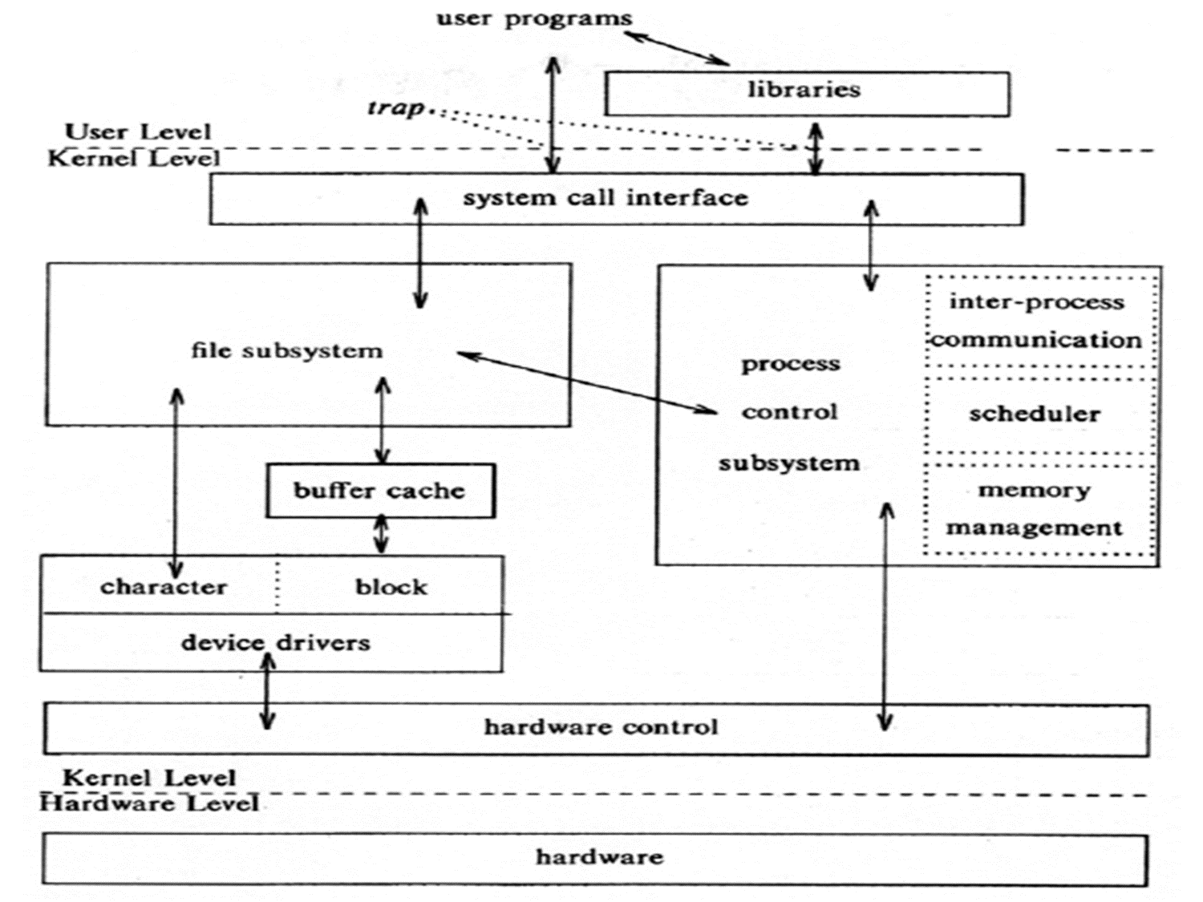
OS – Resource management via virtualization
OS provides services via System Call (typically a few hundred) to run process, access memory/devices/files, etc.
The OS manages resources such as CPU, memory and disk via virtualization.
many programs to run (processes) → Sharing the CPU
many processes to concurrently access their own instructions and data → Sharing memory
many processes to access devices → Sharing disks
The Design Of The Unix Operating System (Maurice Bach, 1986)

Slide 4
Part I: Address Space

Slide 5
Memory Virtualization
What is memory virtualization?
OS virtualizes its physical memory.
OS provides an illusion memory space per each process.
It seems to be seen like each process uses the whole memory .

Slide 6
Benefit of Memory Virtualization
Ease of use in programming
Memory efficiency in terms of time and space
The guarantee of isolation for processes as well as OS
Protection from errant accesses of other processes

Slide 7
OS in The Early System
Load only one process in memory.
Poor utilization and efficiency
0KB
Operating System
(code, data, etc.)
64KB
Current
Program
(code, data, etc.)
max
Physical Memory

Slide 8
Multiprogramming and Time Sharing
Load multiple processes in memory.
Execute one for a short while.
Switch processes between them in memory.
Increase utilization and efficiency.
Cause an important protection issue.
Errant memory accesses from other processes
0KB
Operating System
(code, data, etc.)
64KB
Free
128KB
Process C
(code, data, etc.)
192KB
Process B
(code, data, etc.)
256KB
Free
320KB
Process A
(code, data, etc.)
384KB
Free
448KB
Free
512KB
Physical Memory

Slide 9
Address Space
OS creates an abstraction of physical memory.
The address space contains all about a running process.
That is consist of program code, data, heap, and stack
0KB
Program Code /Data
1KB
Heap
2KB
(free)
15KB
Stack
16KB
Address Space

Slide 10
Address Space(Cont.)
Code
Where instructions live
Data
Global or static local variables
Heap
Dynamically allocate memory.
malloc in C language
new in object-oriented language
Stack
Store return addresses or values.
Contain local variables arguments to routines.
Program Code /Data
Heap
(free)
Stack
Address Space

Slide 11
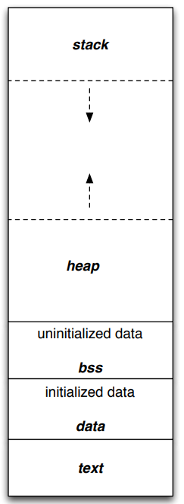
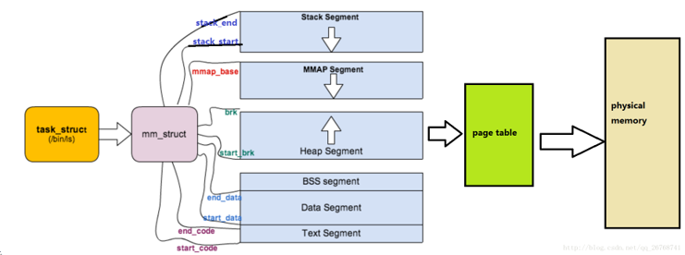
Example from Linux

Slide 12
Virtual Address
Every address in a running program is virtual.
OS translates the virtual address to physical address
#include <stdio.h>
#include <stdlib.h>
int main(int argc, char *argv[]){
printf("location of code : %p\n", (void *) main);
printf("location of heap : %p\n", (void *) malloc(1));
int x = 3;
printf("location of stack : %p\n", (void *) &x);
return x;
}
A simple program that prints out addresses

Slide 13
Virtual Address(Cont.)
The output in 64-bit Linux machine
Address Space
0x400000
Code
(Text)
location of code : 0x40057d
location of heap : 0xcf2010
location of stack : 0x7fff9ca45fcc
0x401000
Data
0xcf2000
Heap
0xd13000
(free)
heap
stack
0x7fff9ca28000
Stack
0x7fff9ca49000

Slide 14
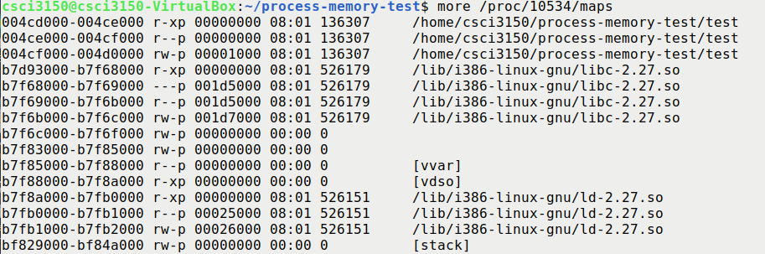
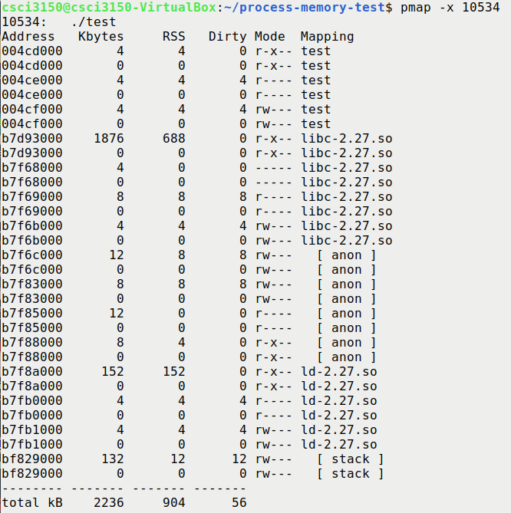
Example: pmap and cat /proc/<pid>/maps
cat /proc/<pid_number>/maps pmap -x <pid_number>

Slide 15
Part II: Address Translation

Slide 16
Memory Virtualizing with Efficiency and Control
Memory virtualizing takes a similar strategy known as limited direct execution(LDE) for efficiency and control.
In memory virtualizing, efficiency and control are attained by hardware support.
e.g., registers, TLB(Translation Look-aside Buffer)s, page-table

Slide 17
Address Translation
Hardware transforms a virtual address to a physical address.
The desired information is actually stored in a physical address.
The OS must get involved at key points to set up the hardware.
The OS must manage memory to judiciously intervene.

Slide 18
Relocation Address Space
The address space start at address 0.
The OS wants to place the process somewhere else in physical memory, not at address 0.

Slide 19
A Single Relocated Process
0KB
0KB
Program Code
Operating System
Heap
16KB
(not in use)
(free)
32KB
Relocated Process
Code
Heap
heap
(allocated but not in use)
stack
48KB
Stack
(not in use)
Stack
64KB
16KB
Physical Memory
Address Space

Slide 20
Base and Bounds Register
0KB
0KB
Program Code
Operating System
Heap
16KB
(not in use)
base register
(free)
32KB
32KB
Code
Heap
heap
(allocated but not in use)
stack
48KB
Stack
(not in use)
Stack
bounds register
64KB
16KB
Physical Memory
16KB
Address Space

Slide 21
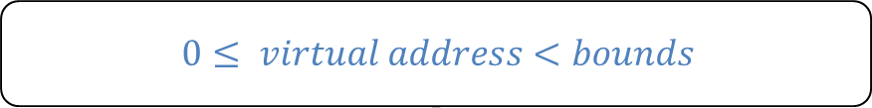

Dynamic(Hardware base) Relocation
When a program starts running, the OS decides where in physical memory a process should be loaded.
Set the base register a value.
Every virtual address must not be greater than bound and negative.
$$phycal address=virtual address+base$$
$$0≤ virtual address<bounds$$

Slide 22
Two ways of Bounds Register
0KB
0KB
Program Code
Operating System
Heap
16KB
(not in use)
(free)
32KB
Code
$$physical address of$$
$$the end of$$
$address space$
$$the size of$$
$$address spacee$$
Heap
(allocated but not in use)
bounds
bounds
16KB
48KB
Stack
48KB
(not in use)
Stack
64KB
Physical Memory
16KB
Address Space

Slide 23
Physical Memory
Base Register
0 KB
1 KB
P1
2 KB
3 KB
same code
4 KB
P2
5 KB
6 KB

Slide 24
Base Register
0 KB
1 KB
base register
P1
2 KB
P1 is running
3 KB
4 KB
P2
5 KB
6 KB

Slide 25
Base Register
0 KB
1 KB
P1
2 KB
P2 is running
3 KB
4 KB
base register
P2
5 KB
6 KB

Slide 26
Base Register
(Decimal notation)
0 KB
Virtual
Physical
P1: load 100, R1
1 KB
P1
2 KB
3 KB
4 KB
P2
5 KB
6 KB

Slide 27
Base Register
0 KB
Virtual
Physical
P1: load 100, R1
load 1124, R1
(1024 + 100)
1 KB
P1
2 KB
3 KB
4 KB
P2
5 KB
6 KB

Slide 28
Base Register
0 KB
Virtual
Physical
P1: load 100, R1
load 1124, R1
1 KB
P1
P2: load 100, R1
2 KB
3 KB
4 KB
P2
5 KB
6 KB

Slide 29
Base Register
0 KB
Virtual
Physical
P1: load 100, R1
load 1124, R1
1 KB
P1
P2: load 100, R1
load 4196, R1
(4096 + 100)
2 KB
3 KB
4 KB
P2
5 KB
6 KB

Slide 30
Base Register
0 KB
Virtual
Physical
P1: load 100, R1
load 1124, R1
1 KB
P1
P2: load 100, R1
load 4196, R1
2 KB
P2: load 1000, R1
3 KB
4 KB
P2
5 KB
6 KB

Slide 31
Base Register
0 KB
Virtual
Physical
P1: load 100, R1
load 1124, R1
1 KB
P1
P2: load 100, R1
load 4196, R1
2 KB
P2: load 1000, R1
load 5096, R1
3 KB
4 KB
P2
5 KB
6 KB

Slide 32
Base Register
0 KB
Virtual
Physical
P1: load 100, R1
load 1124, R1
1 KB
P1
P2: load 100, R1
load 4196, R1
2 KB
P2: load 1000, R1
load 5096, R1
P1: load 1000, R1
3 KB
4 KB
P2
5 KB
6 KB

Slide 33
Base Register
0 KB
Virtual
Physical
P1: load 100, R1
load 1124, R1
1 KB
P1
P2: load 100, R1
load 4196, R1
2 KB
P2: load 1000, R1
load 5096, R1
P1: load 1000, R1
load 2024, R1
3 KB
4 KB
P2
5 KB
6 KB

Slide 34

Base Register
0 KB
Virtual
Physical
P1: load 100, R1
load 1124, R1
1 KB
P1
P2: load 100, R1
load 4196, R1
2 KB
P2: load 1000, R1
load 5096, R1
P1: load 1000, R1
load 2024, R1
3 KB
4 KB
P2
5 KB
Can P2 hurt P1? Can P1 hurt P2?
6 KB
How to protect process with base register?

Slide 35
Base Register
0 KB
Virtual
Physical
P1: load 100, R1
load 1124, R1
1 KB
P1
P2: load 100, R1
load 4196, R1
2 KB
P2: load 1000, R1
load 5096, R1
P1: load 1000, R1
load 2024, R1
3 KB
P1: store 3072, R1
store 4096, R1
(3072 + 1024)
4 KB
P2
5 KB
Can P2 hurt P1? Can P1 hurt P2?
6 KB
How to protect process with base register?

Slide 36
Base + Bounds
0 KB
1 KB
base register
P1
2 KB
bounds register
P1 is running
3 KB
4 KB
P2
5 KB
6 KB

Slide 37
Base + Bounds
0 KB
1 KB
P1
2 KB
P2 is running
3 KB
4 KB
base register
P2
5 KB
bounds register
6 KB

Slide 38
Base + Bounds
0 KB
Virtual
Physical
P1: load 100, R1
load 1124, R1
1 KB
P1
P2: load 100, R1
load 4196, R1
2 KB
P2: load 1000, R1
load 5096, R1
P1: load 1000, R1
load 2024, R1
3 KB
P1: store 3072, R1
4 KB
P2
5 KB
Can P1 hurt P2?
6 KB

Slide 39
Base + Bounds
0 KB
Virtual
Physical
P1: load 100, R1
load 1124, R1
1 KB
P1
P2: load 100, R1
load 4196, R1
2 KB
P2: load 1000, R1
load 5096, R1
P1: load 1000, R1
load 2024, R1
3 KB
P1: store 3072, R1
Exception
3072 > 1024
4 KB
P2
5 KB
Can P1 hurt P2?
6 KB

Slide 40

Base + Bounds
0 KB
Virtual
Physical
P1: load 100, R1
load 1124, R1
1 KB
P1
P2: load 100, R1
load 4196, R1
2 KB
P2: load 1000, R1
load 5096, R1
P1: load 1000, R1
load 2024, R1
3 KB
P1: store 3072, R1
Exception
3072 > 1024
4 KB
P2
5 KB
Can P1 hurt P2?
6 KB

Slide 41
OS Issues for Memory Virtualizing
The OS must take action to implement base-and-bounds approach.
Three critical junctures:
When a process starts running:
Finding space for address space in physical memory
When a process is terminated:
Reclaiming the memory for use
When context switch occurs:
Saving and storing the base-and-bounds pair

Slide 42
OS Issues: When a Process Starts Running
The OS must find a room for a new address space.
free list : A list of the range of the physical memory which are not in use.
0KB
Operating System
The OS lookup the free list
16KB
Free list
(not in use)
16KB
32KB
Code
Heap
(allocated but not in use)
48KB
Stack
48KB
(not in use)
64KB
Physical Memory

Slide 43
OS Issues: When a Process Is Terminated
The OS must put the memory back on the free list.
Free list
0KB
Operating System
Free list
0KB
Operating System
16KB
16KB
16KB
16KB
(not in use)
(not in use)
32KB
32KB
Process A
32KB
(not in use)
48KB
48KB
48KB
(not in use)
(not in use)
48KB
64KB
64KB
Physical Memory
Physical Memory

Slide 44
OS Issues: When Context Switch Occurs
The OS must save and restore the base-and-bounds pair.
In process structure or process control block(PCB)
Process A PCB
…
base : 32KB
bounds : 48KB …
0KB
Operating System
0KB
Operating System
Context Switching
16KB
(not in use)
16KB
(not in use)
base
base
32KB
32KB
32KB
48KB
Process A
Currently Running
Process A
bounds
bounds
48KB
48KB
48KB
64KB
Process B
Process B
Currently Running
64KB
64KB
Physical Memory
Physical Memory

Slide 45
Summary
Address Space – an abstraction of physical memory created by OS
The address space contains all about a running process.
That is consist of program code, data, heap, and stack
Address Translation – Hardware-based Address Translation
The hardware transforms each memory access (e.g., an instruction fetch, load, or store), changing the virtual address provided by the instruction to a physical address where the desired information is actually located .
OS performs memory management – keeping track of which locations are free and which are in use, and judiciously intervening to maintain control over how memory is used.
The Base and Bounds Approach
When a program starts running, the OS decides where in physical memory a process should be loaded
The hardware checks whether virtual addresses are in bounds.
Next: Memory Management (Chapters 16, 17, 18, 19, 20, 21, 22, 23)

